Slide 1
GIS Workshop

Slide 2
A little bit about me….
Lin Lu
luckylulin@g.ucla.edu
Math/atmospheric & oceanic sciences
GIS minor
FB: Lucky Lin Lu
California Geographical Society

Slide 3
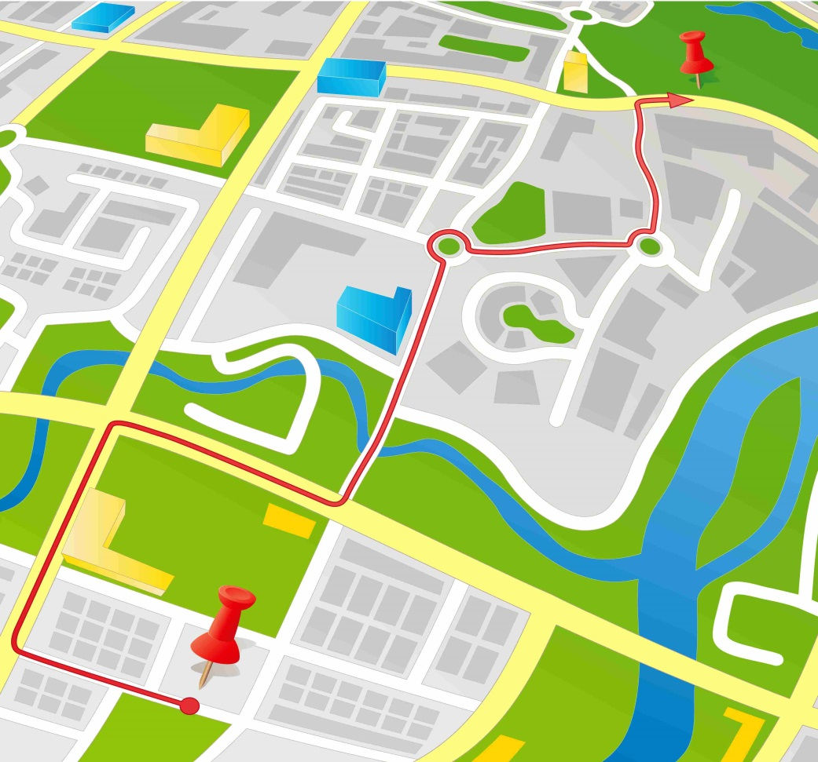
Everyday GIS
Navigation
Cognitive Mapping: landmark knowledge, route phase, survey knowledge
Direction?

Slide 4
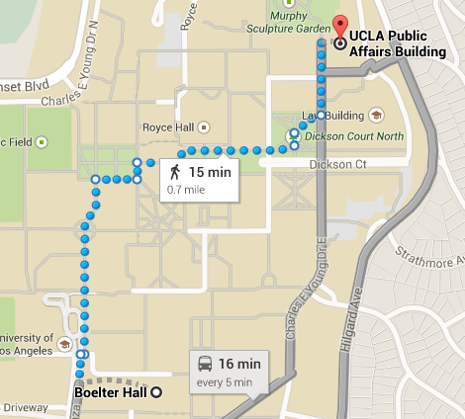
Everyday GIS
Navigation
GIS helps us find shortcuts
Google Maps, etc.

Slide 5
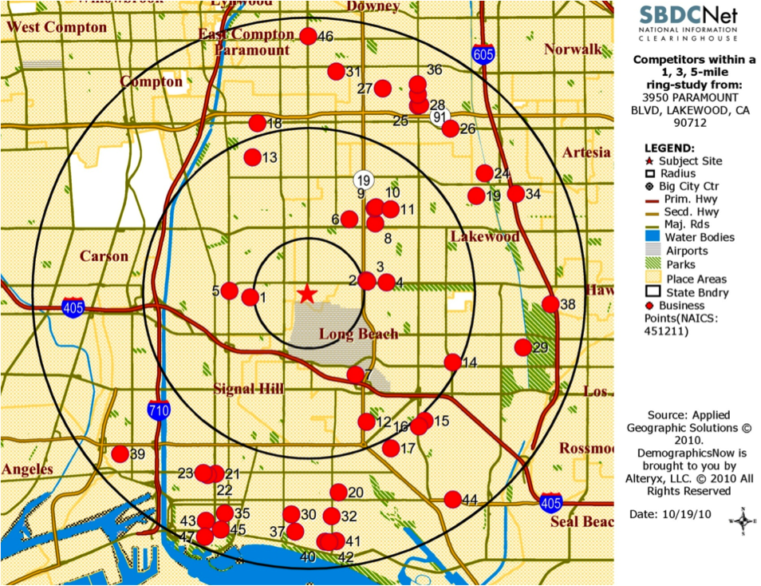
GIS for Business
Marketing
Banks, grocery stores, restaurants, hospitals are very concerned about their….
Location?

Slide 6
GIS for Business
Marketing
Distance, location and travel is key for consumers too!
Yelp
Uber

Slide 7
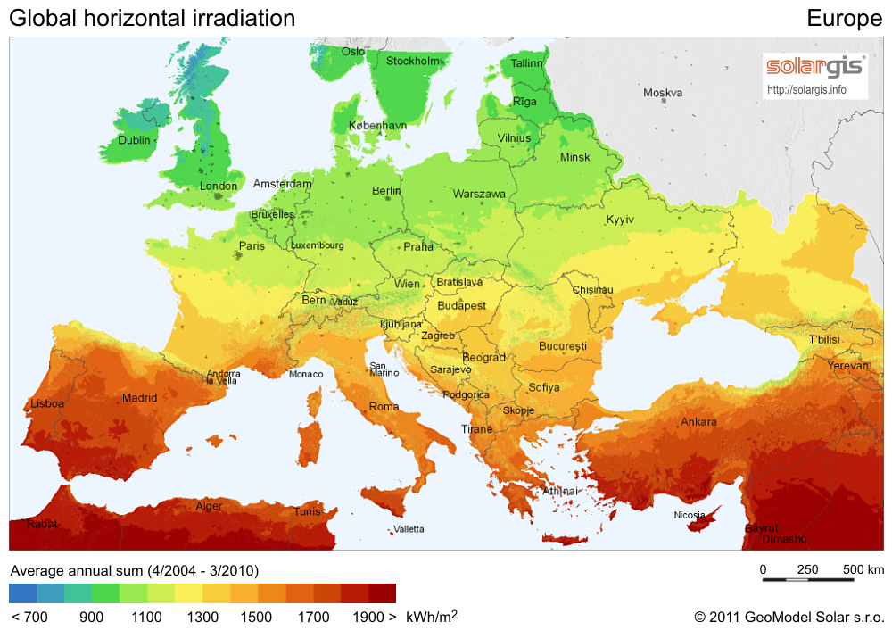
Science and GIS
GIS in Science
Our Most Important Problems have a spatial component!
Researchers map: disease contagion; population movements; impacts of climate change; transportation patterns…
Quantification?

Slide 8
Science and GIS
GIS in Science
Example: Ebola outbreak response

Slide 9
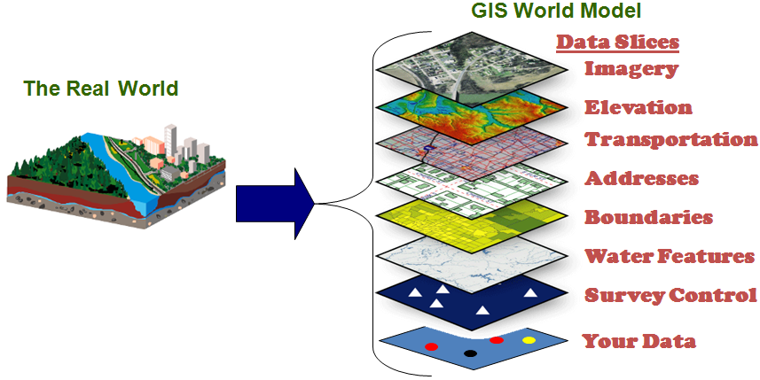
A Basic Model of Sea Level Rise
Key problems require complex spatial data
What should we take into account?

Slide 10
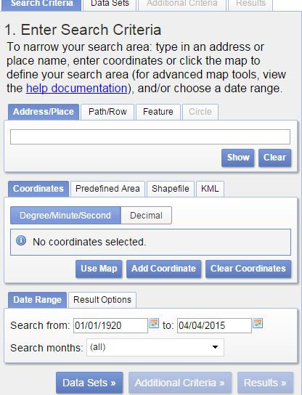
Step1: Obtain original data
USGS Earth explorer website
>> select specific location
>> data set – digital elevation –
SRTM—SRTM voil filled
>> click ‘Results’
>> download the 1-arc resolution file

Slide 11
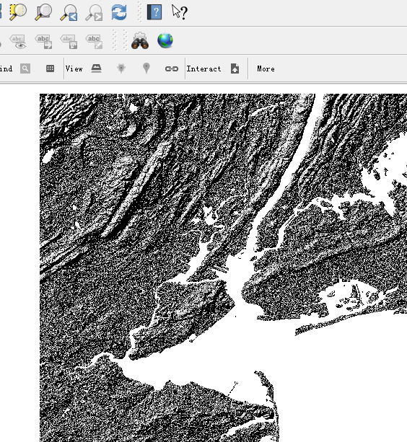
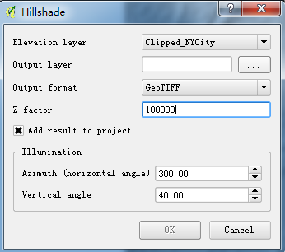
Step2: Create a Hillshade map
Open QGIS >> add raster layer
>> ‘raster’ – ‘terrain analysis’– ‘hillshade’
>> adjust different parameters accordingly

Slide 12
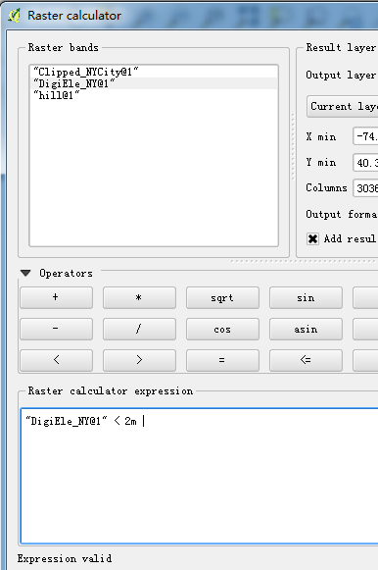
Step3: Perform queries
‘raster’– click ‘raster calculator’
>> type in specific expression
NY_below_ft

Slide 13
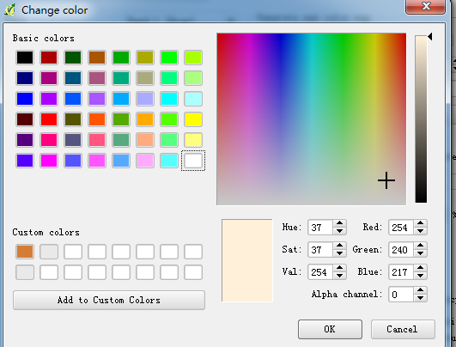
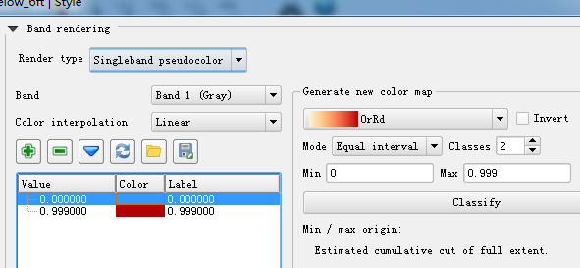
Step4: Create visualization
Right click your file—select ‘properties’—
‘style’
>> adjust render type, choose spectrum, change mode and classes
>> adjust ‘alpha channel’ of the white colored area

Slide 14
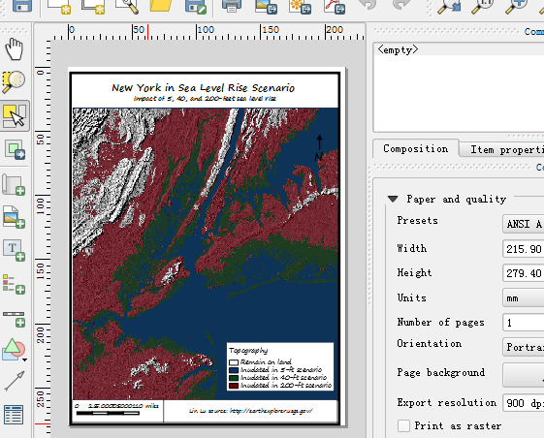
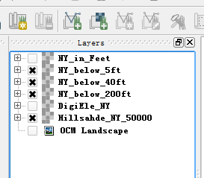
Step5: Add layers and Base-map
Customize your layers using different colors
>> rearrange the order of layers created
>> add one base map using ‘OpenLayers Plugin’
>> output your maps in the print composer
>> add necessary elements such as caption, reference sites, your names…..

Slide 15
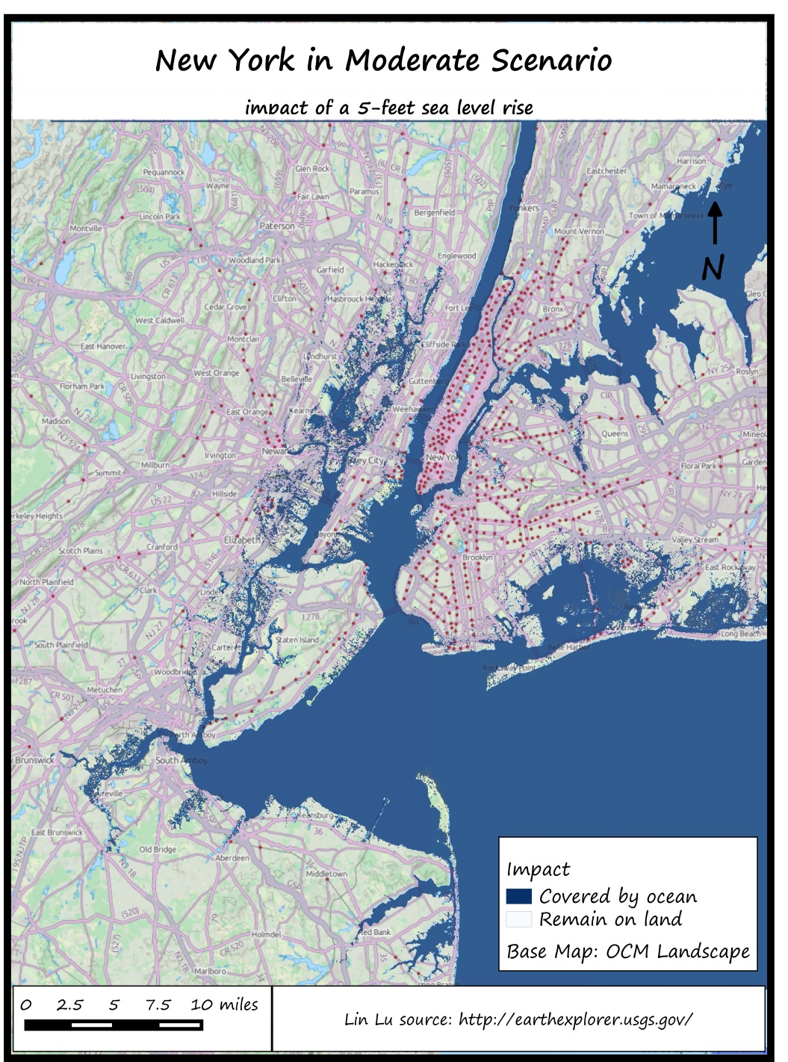
So here you go!

Slide 16
Activity Questions…
Limits behind modeling sea level rise?
i.e. what are some of the factors we fail to consider?
The real world is complicated but scientific/spatial modeling helps us to simplify some of the complexity to help understand real problems.
Storm Surge Inundation Map by EPA
Link: http://water.epa.gov/infrastructure/watersecurity/climate/stormsurge.cfm

Slide 17
Thank You!
Contact info: Lin Lu
luckylulin@g.ucla.edu 3109104482
Course recommended: Geography 7
Resources:
USGS Earth Explorer
GIS Lounge
My GIS Jobs
GISjobs.com

